Slide 1


532 Final Presentation
Junjie Wang

Slide 2


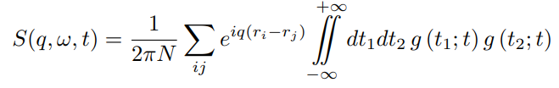


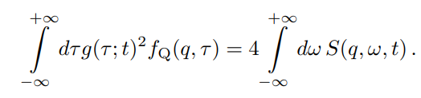
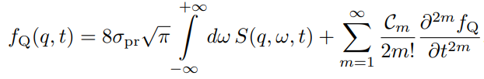


Witnessing Light-Driven Entanglement using Time-Resolved Resonant Inelastic X-Ray Scattering
Witnessing Requires
measuring cross section of light driven material
Evaluate transient dynamical structure factor
Calculating QFI
Determining quantum bounds signaling
the QFI informs about the presence of an entangled many-body state if its value exceeds a minimum value derived from the quantum (Cramer-Rao) bound
quantum Fisher information(QFI): witness a lower bound for the entanglement depth
entanglement depth: minimum number of entangled modes required to construct a specific many-body state
instantaneous QFI density
S: (experimental accessible)dynamical structure factor
Completely determined by instantaneous wavefunction
Find f_Q serves the purpose of witnessing entanglement in a transient k-partite quantum state when exceeding its operator specific Cramer-Rao bound
Signals at least bipartite entanglement

Slide 3




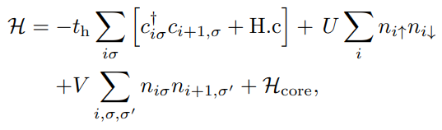



Conti.
trRIXS: Photon – in – Photon – out scattering process
Cross section:
Due to the spin-orbit coupling of the core levels, D is the pair of photon absorption and emission events may flip spin.
This spin-flip process is maximized for the π − σ polarization and, therefore, provides a good estimate of the dynamical structure factor
the creation (annihilation) operators : c – valence, p- core
Extended Hubbard Model
The “extended” is characterize the extra on-site Coulomb repulsion U, and nearest-neighbor interaction V

Slide 4
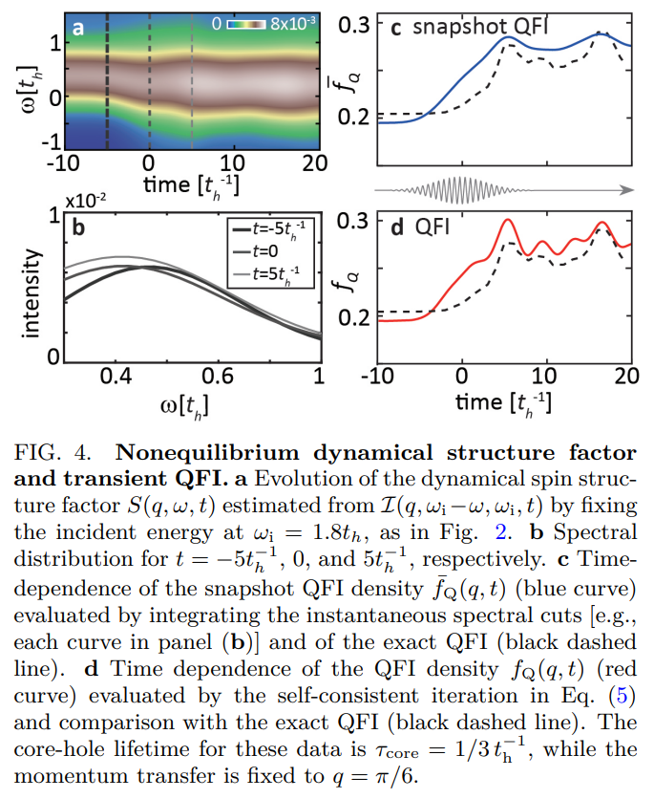
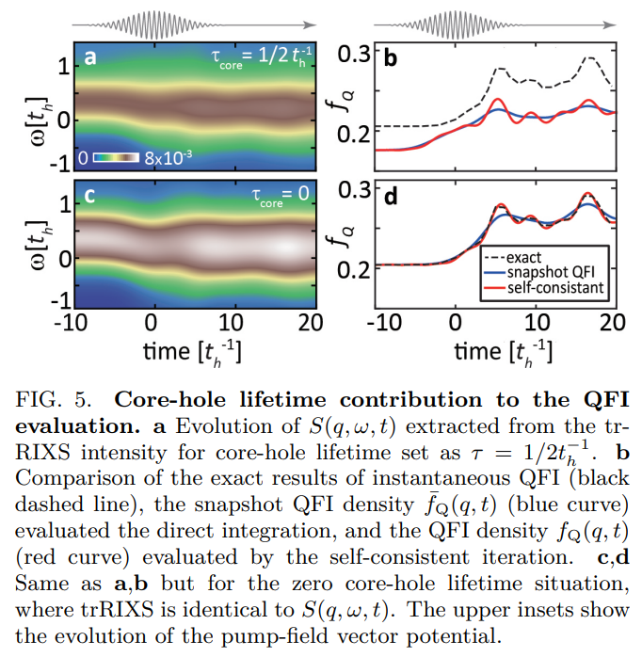
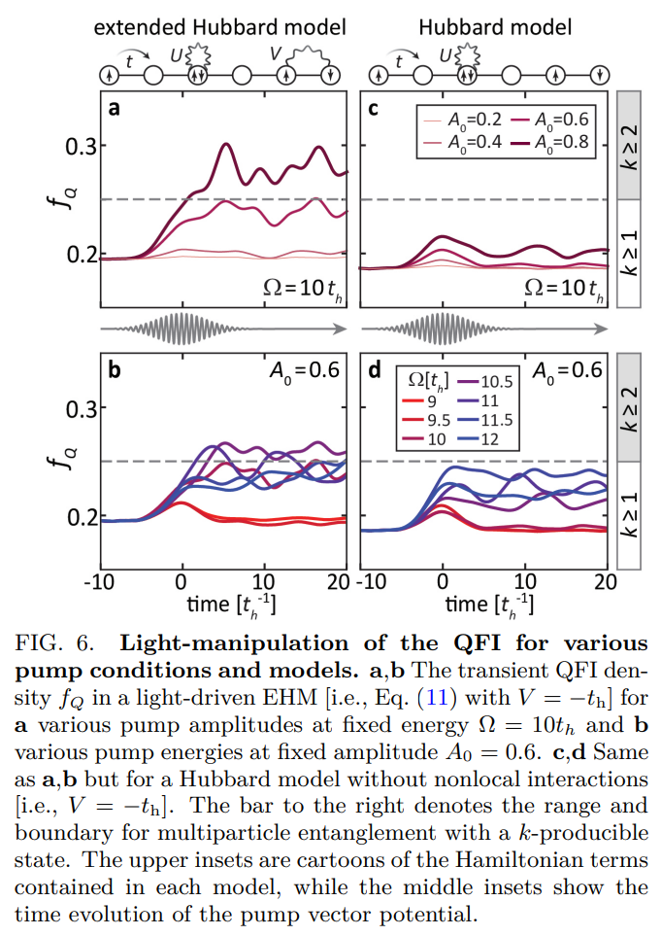
Results.
not have enough energy to create doublon-hole pairs and scramble the spin configurations
Convolution effect by finite probe width
at least bipartite entangled
Lifetime is infinitesimal
which exhibits the most evident spectral changes and captures the longest-range correlations supported by our system size

Slide 5


Moving Forward
Fermi Entanglement
BCS theory
Paired Entanglement
Entanglement Depth Measurement
Pair Measurements

Slide 6
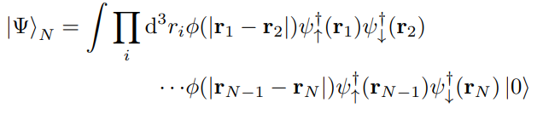
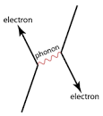
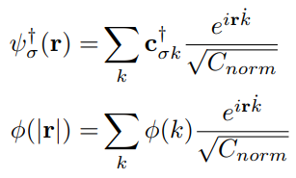
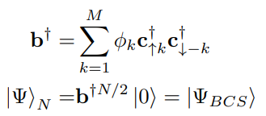
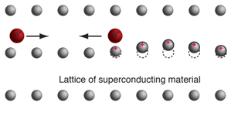


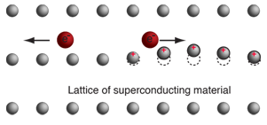
BCS Pair
Cooper pair
2 electron-Pair
Weak interaction by Phono
Behave collectively as Boson
Total Energy Below fermi Energy
result as Superconductor

Slide 7




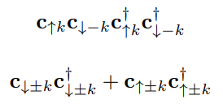
Pair Measurements
Detecting Pair (Mostly use Hamiltonian as Witness):
For BSC state in non-number conserving pairs:
The Detector is:
If the pair exists:
Measure Pair:
Intuition: Linear Combination of

Slide 8


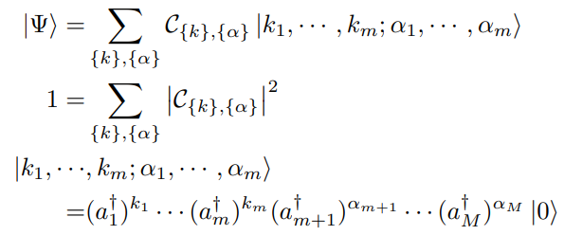
Entanglement Depth Measurement
Entanglement Depth
Using Bipartition
Check if entanglement appear between two sub-system
Pure State:
If there Expectation can be written as Product Form
For the mixing state:
If the Off-Diagonal Terms Exist
Entanglement between pair:
Boson Form
Entanglement between electron:
Fermi Form

Slide 9
Thank You
No Question?

